Slide 1


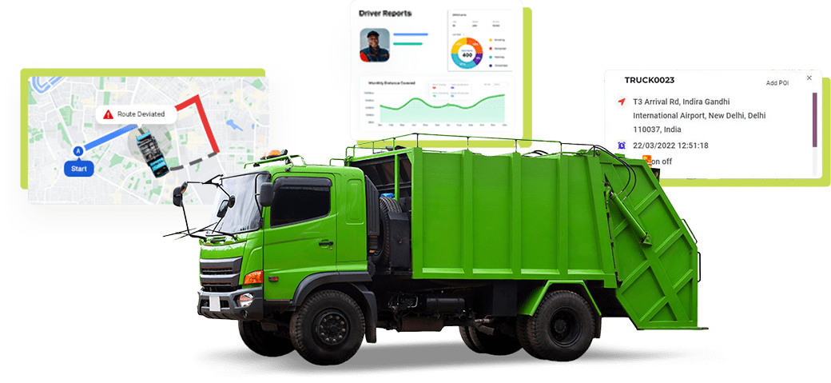
Garbage Collection and Tracking System
Group 4:
Kanishk Tawde
Arslan Parkar
Atharva Deshpande

Slide 2
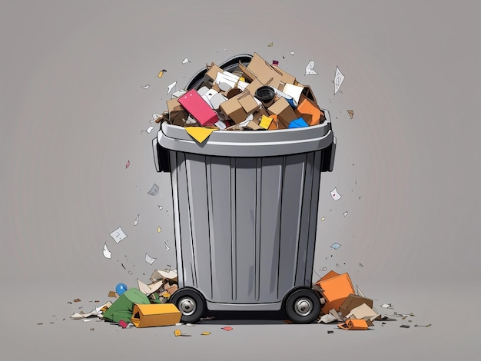
PROBLEM STATEMENT
PROBLEM STATEMENT Urban waste management poses significant challenges in cities worldwide. Overflowing garbage bins and inefficient waste collection methods lead to environmental hazards, public health concerns, and logistical inefficiencies. Traditional methods rely heavily on manual monitoring and predetermined schedules, which fail to address real-time variations in waste generation. This often results in missed collections, underutilization of resources, and citizen dissatisfaction.
CHALLENGES
1
Inefficient routing of garbage collection vehicles.
2
Lack of actionable insights into waste patterns for city planners.
3
Minimal citizen engagement and feedback in waste management systems.

Slide 3
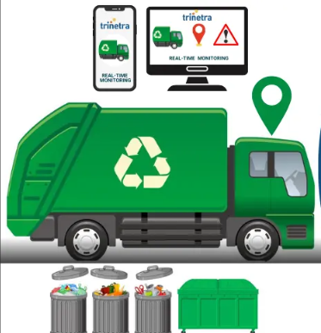
SOLUTION AND FOCUS AREAS
SOLUTION The Garbage Collection and Tracking System is a data-driven platform designed to optimize urban waste collection. It integrates citizen reporting and data aggregation to streamline waste management. The system allows for real-time monitoring, basic route prioritization, and efficient task management, enabling seamless collaboration between citizens, administrators, supervisors and drivers.
CORE FOCUS AREAS
Citizen Reporting: Java application for citizens/users to report full bins.
Business Intelligence: Generate analytics/reports for supervisor, admin, and user.
Route Assignment: Implement a basic rule-based prioritization instead of complex optimization algorithms.
Driver Interaction: Provide a simple module for drivers to mark bins as collected.
Admin Monitoring: Allow administrators to view reports and assign bins to drivers.

Slide 4
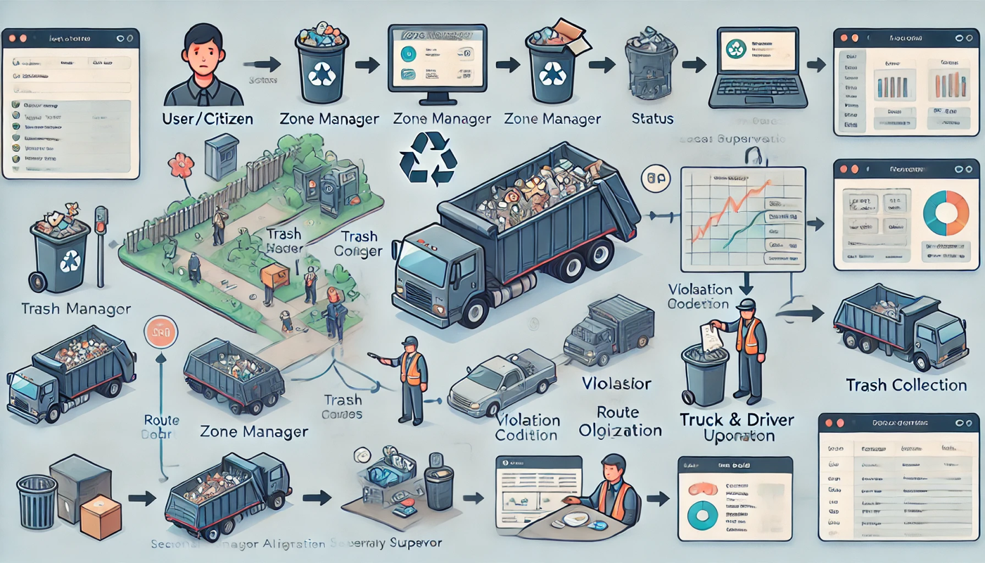
HIGH LEVEL COMPONENT DIAGRAM

Slide 5
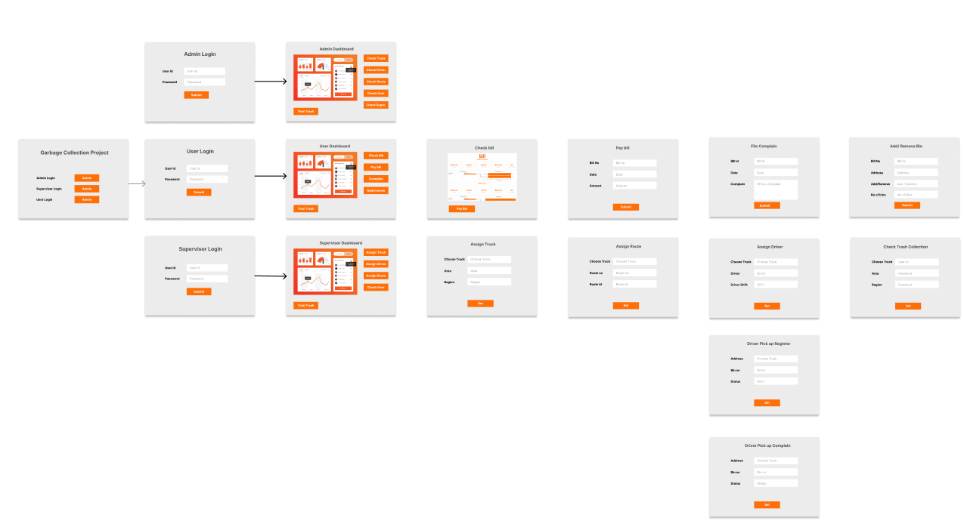
SCREEN FLOW/USER INTERACTION DIAGRAM

Slide 6
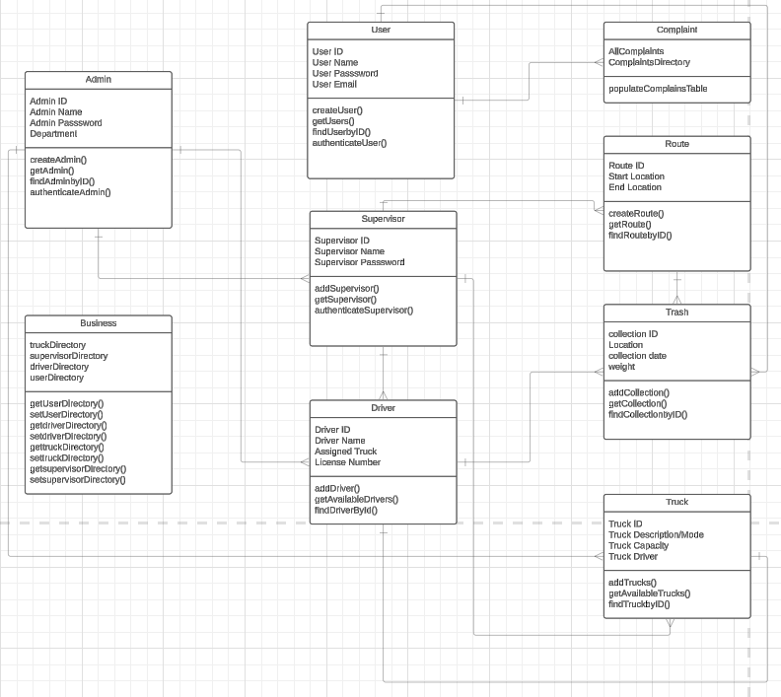
UML DIAGRAM

